Slide 1

Network Security & Cryptography
Brajesh Kumar Sharma
Sir Padampat Singhania University
Bill Figg

Slide 2
What is a network?
A network consists of two or more devices that are linked in order to share resources or allow communications.
Can you think of various forms of a network?

Slide 3




Computer Networks
Send in
homework
Download
music
facebook
INTERNET
email
chat
Notes:
Computers sharing the internet or sharing a printer?

Slide 4
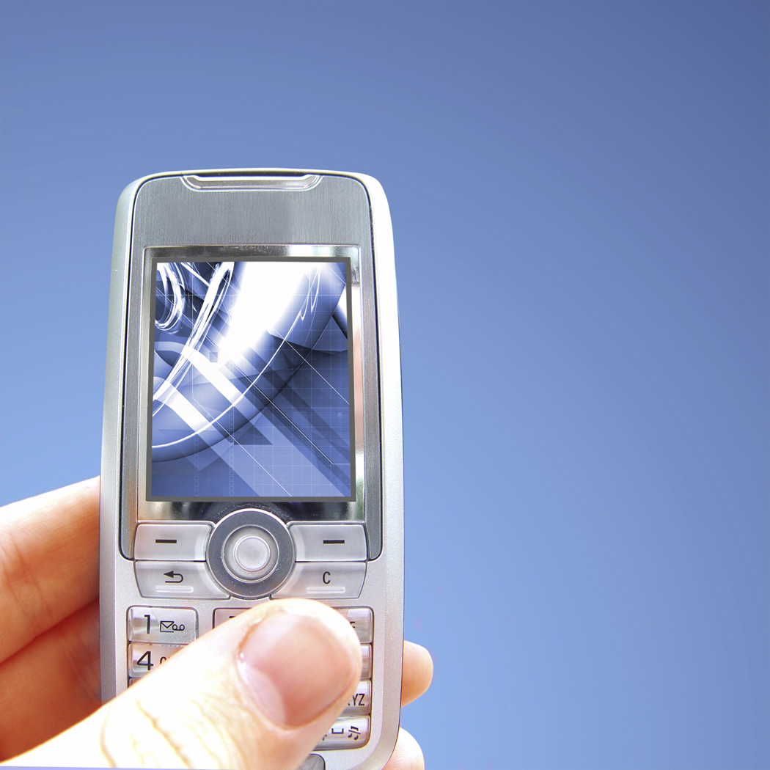
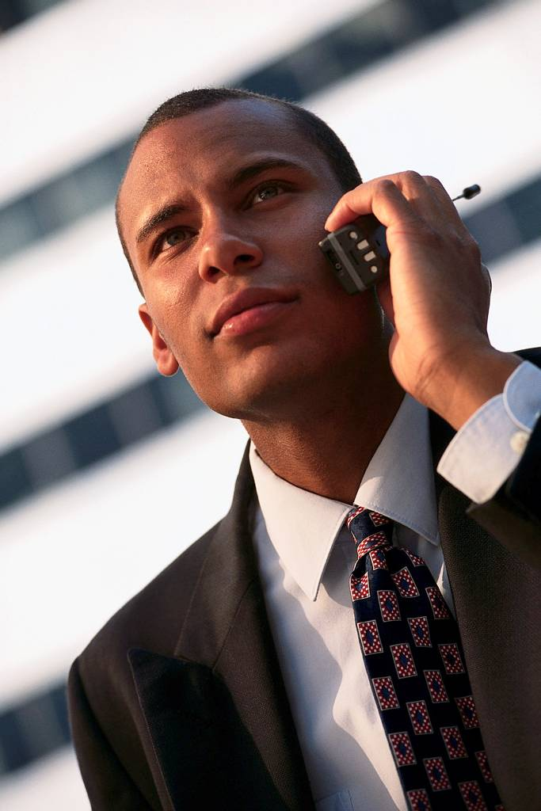
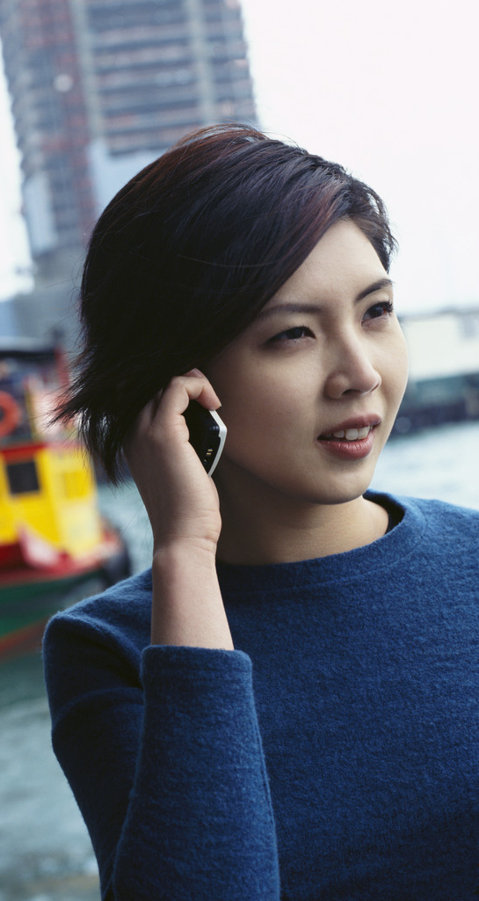
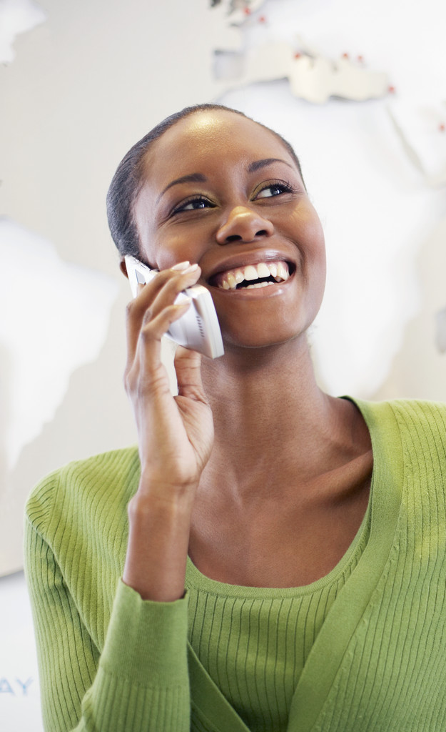


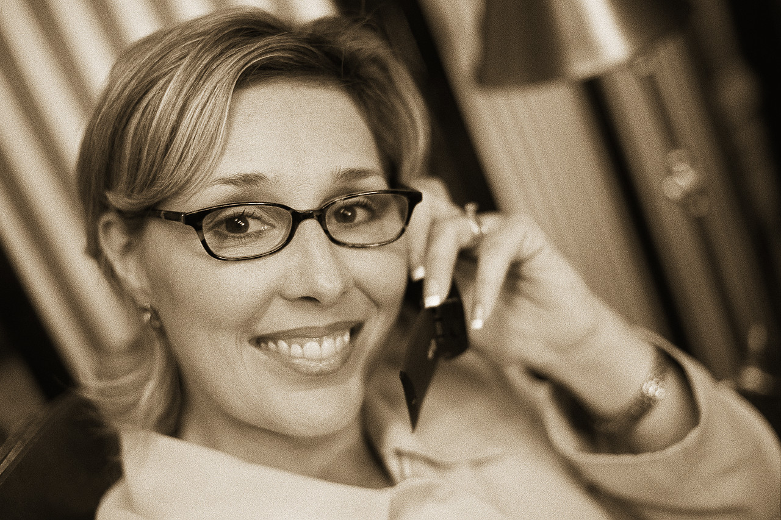

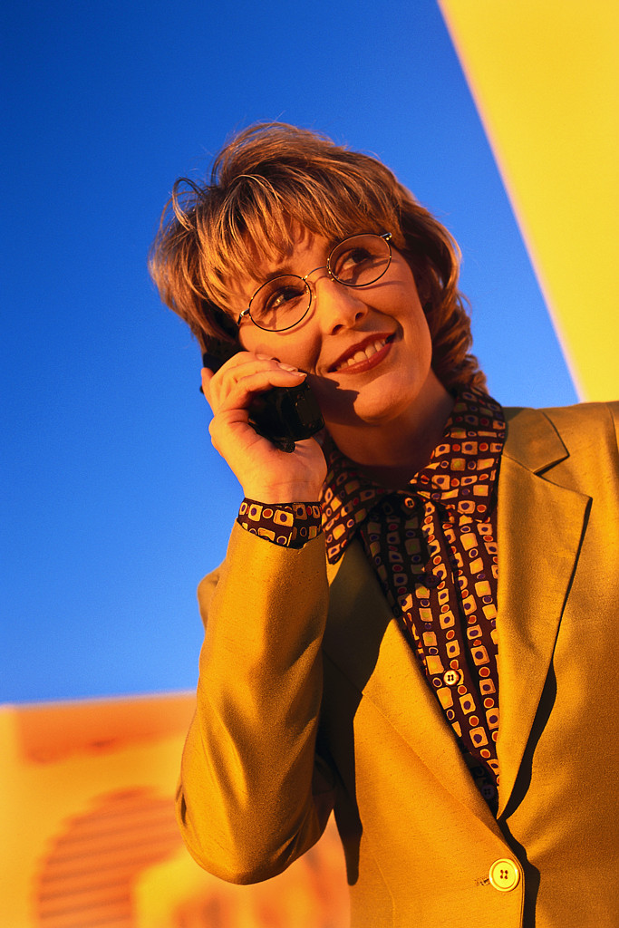
Phone Networks
business
call
Text
messaging
call
friend
call
mum
Transmitter
tower
Transmitter
tower
Text
messaging
call
friend
call
daughter
business
call
Text
messaging
Notes:
This is a wireless network

Slide 5


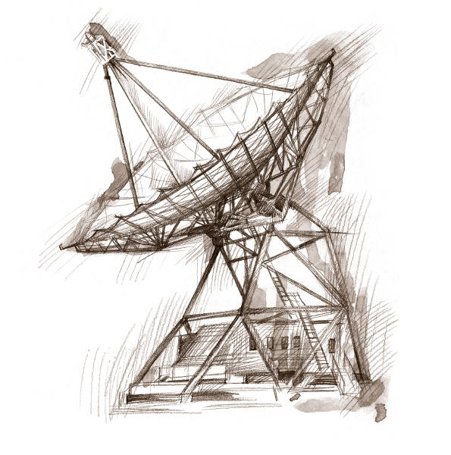

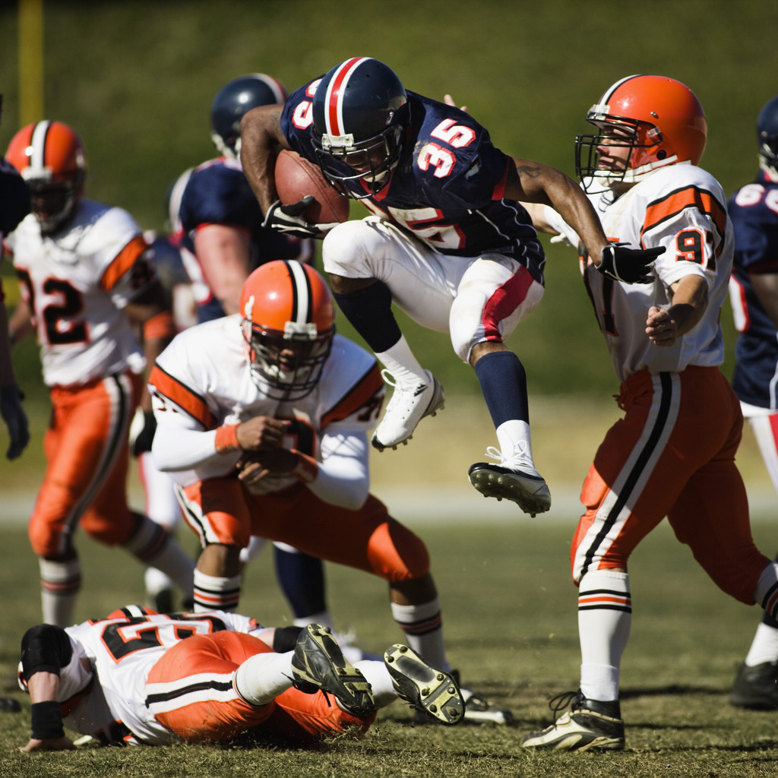
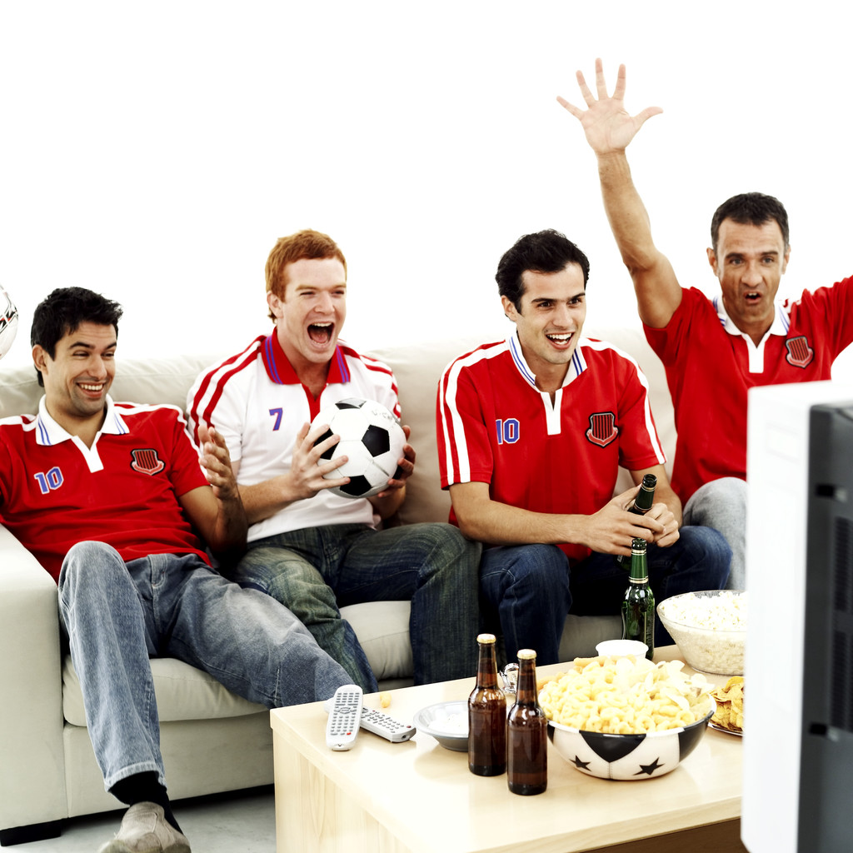


Satellite
Networks
Dish network
Football game
in Europe
Watching the game
In Bryan Texas, USA
Notes:
Can you think of other types of Communication networks?
Think about how people communicated before the advent of the internet or cell phone?

Slide 6
What is security?
Security is the act of protecting a person, property or organization from an attack.
Examples of attack on a person?
Examples of attack on a property?
Examples of attack on a organization?
Notes:
Attack on a person:
Physical attacks are efforts to injury or even kill a person. Other types personal attacks can also be attempts to injure or hurt someone emotionally or financially. Sometimes there is even an attack to destroy a person's reputation.
Attack on a property? Someone may try to damage or destroy property, such as a building. Theft is also considered a property attack.
Attack on organization
Groups or individuals may wish to damage, undermine or destroy an organization, such as a company or even a government. Attacks may involve sabotage, creating unrest among the people, damaging property or even killing leaders. Terrorists try to destroy a government or society through damaging property or randomly killing or injuring people.

Slide 7

Why do we need network security
bad guy
listens to the
communication
INTERNET
sensitive data
email
Name: ALICE JACK
Address: 1 BALL STR
Phone Number: 888-9191
DOB: 01/21/1993
SSN: 999-111-2323
Credit Card No:. 9988 5321
Medical Records, Test scores
School Nurse
Notes:
Can you think of sensitive types of data that an attacker or bad guy may like to see? Bank accounts etc

Slide 8

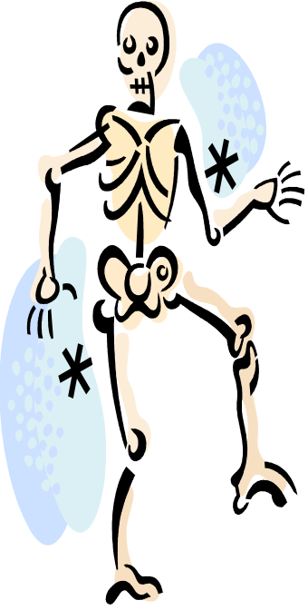
Why do we need network security?
Can you think of ways a bad guy can use the data he obtains to cause harm or attack? Give examples and reasons for attacks.
Can you think of what you can do to prevent a bad guy from having access to your private data or information?
Notes:
E.g. Email passwords, bank account information, locking your door with a key, locking your car with a key too, etc.
Don’t write your passwords anywhere, lock sensitive data in a safe,
Reasons for attacks: Revenge, money, political, thrills, avoid getting caught.

Slide 9
Cryptography
Cryptography
  The process of converting a message into a secret code called CIPHER TEXT, and changing the encoded message back to regular text called PLAIN TEXT.
(1) Encryption
  The conversion of the original message into a secret code or CIPHER TEXT using a key.
(2) Decryption
  The conversion of the encoded message or PLAIN TEXT back to the original message using the same key.

Slide 10
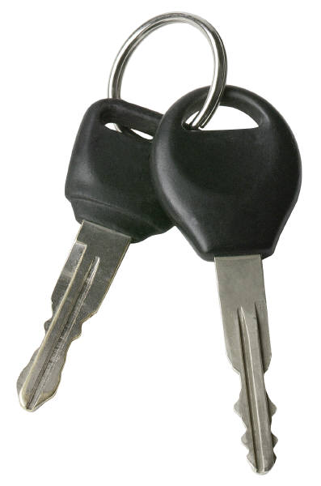

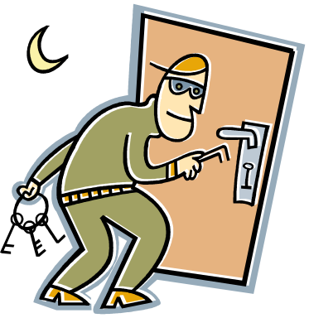




Its All About Keys !!!
My name is
Alice Jack.
Encryption
cypher text
Plain text
key
key
Wi xkwo sc kvsmo tkmu
Decryption
My name is
Alice Jack.
Notes:
Talk about car keys, padlock keys, house keys, password keys….. What happens if the bad guy gets your keys?

Slide 11
Cryptography Wheel
Y
Z
A
B
You are meeting your friend for lunch at a restaurant. Which one? – it’s a secret!
X
C
W
Y
Z
A
B
D
X
C
V
W
D
E
U
V
E
F
U
F
T
T
G
G
S
S
H
H
Golden Corral
R
I
R
Q
J
I
Q
P
K
J
O
N
M
L
P
K
ENCRYPTION
O
M
L
N
Key = 4
PLAIN TEXT
CIPHER TEXT

Slide 12
Cryptography Wheel
Z
A
Golden Corral
Y
B
X
C
W
V
W
X
Y
D
U
Z
V
T
A
E
ENCRYPTION
S
B
U
R
F
Key = 4
C
T
Q
D
G
S
P
E
H
Dliabk zlooxi
O
F
R
I
N
G
Q
M
H
J
DECRYPTION
L
K
J
I
P
K
O
M
L
N
Golden Corral
PLAIN TEXT
CIPHER TEXT
Notes:
Decrypt.

Slide 13
Cryptography Wheel
Y
Z
A
B
X
C
W
S
T
U
V
D
R
W
Lyx Fivmnyl
V
Q
X
E
P
Y
U
O
F
Key = 7
Z
T
A
G
DECRYPTION
N
S
M
B
H
R
L
C
I
K
D
Red Lobster
Q
J
E
J
I
H
G
F
P
K
O
M
L
N
Go to Worksheet
PLAIN TEXT
CIPHER TEXT
Notes:
Decrypt.

Slide 14
A problem
The art museum in Bryan, Texas wants to transport a very valuable painting of Mona Lisa to the White house in Washington D.C. for an art exhibition scheduled for Halloween day.
The director must communicate to the Washington D.C. office the details for transporting the painting:
Date and time of flight arrival, Name of airline and airport of arrival, name of courier.
Notes:
Use this in case there is extra time to work!

Slide 15
Mona Lisa secret?
However, the museum director has learnt that a very notorious band of robbers called CASTERS want to intercept and steal the painting while in transit.
He will need to encrypt the transportation information so the CASTERS will not easily target the painting.

Slide 16
Key: GCF of 13 and 39
PBAGVARAGNY NVEYVAR NEEVIVAT NG QHYYRF NVECBEG NG GJB CZ BA GUHEFQNL GJRYSGU BS BPGBORE GJB GUBHFNAQ NAQ RVTUG, PBHEVRQ OL ZE NQVQNF XBFURE.
References: http://cryptoclub.math.uic.edu/php/joke.php
http://www.school-for-champions.com/security/whatis.htm
Notes:
Answer:
Continental airline arriving at dulles airport at two pm on Thursday twelfth of october two thousand and eight, couried by mr adidas kosher.

Slide 17
TEKS Covered
6.1 - Number, operation, and quantitative reasoning.
(E) Identify factors of a positive integer, common factors and the greatest common factor of a set of positive integers.
6.11 - The student applies mathematics to solve problems connected to everyday experiences, investigations in other disciplines, and activities in and outside of school.
(A) Identify and apply mathematics to everyday experiences, to activities in and outside of school, with other disciplines, and with other mathematical topics;
(B) Use a problem-solving model that incorporates understanding the problem, making a plan, carrying out the plan, and evaluating the solution for reasonableness;

